Slide 1
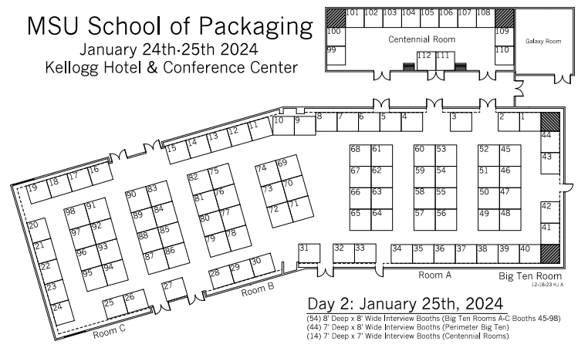
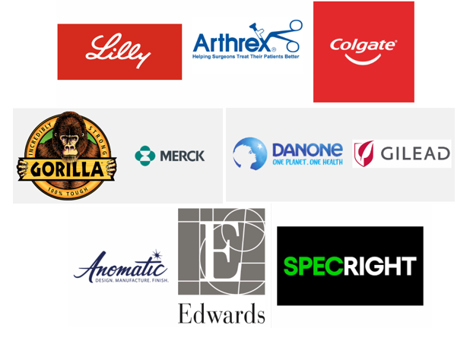
A special thank you to our SPONSORS:
GOLD
PLATINUM

Slide 2
Booth |  | Booth |  | Booth |  | Booth
1 | Edwards Lifesciences | 26 | Kimberly-Clark | 51 | Amcor | 76 | Equity Packaging, Inc.
2 |  | 27 | Zimmer Biomet | 52 |  | 77 | Welch Packaging
3 | Materne NA GoGo squeeZ | 28 | Boston Scientific | 53 | Conagra Brands | 78 | Basic American Foods
4 | Kellanova | 29 | The Clorox Company | 54 |  | 79 | Toyota
5 | Church & Dwight Co., Inc. | 30 | Perrigo | 55 | Gilead Sciences | 80 | Mattel, Inc.
6 | Organon | 31 | Mars, Inc. | 56 |  | 81 | Silgan Containers
7 | tms | 32 | Styropek | 57 | Specright | 82 | The Kraft Heinz Company
8 | Packaging Compliance Labs | 33 | The Hershey Company | 58 |  | 83 | AbbVie
9 | Lutron Electronics Company, Inc. | 34 | PepsiCo | 59 | Danone North America | 84 | Coastal Container
10 | Crown Cork and Seal USA, Inc. | 35 | Packaging Corporation of America | 60 |  | 85 | Johnson & Johnson Family of Companies
11 | Sherwin-Williams Company | 36 | Sonoco Products Company | 61 | Merck & Co., Inc. | 86 | Menasha Corporation
12 | Cummins Inc. | 37 | Highlight Industries INC | 62 |  | 87 | Bryce Corporation
13 | Medtronic | 38 | S.C. Johnson & Son, Inc. | 63 | Colgate-Palmolive | 88 | Post Consumer Brands
14 | Hormel Foods Corporation | 39 | Mondelez International | 64 |  | 89 | Abbott
15 | Hill's Pet Nutrition | 40 | PCI Pharma Services | 65 | Pregis LLC | 90 | Kruger Family Industries (Penda/TriEnda)
16 | Winland Foods | 41 | Edgewell Personal Care | 66 | CartonCraft Inc | 91 | ESS Inc.
17 | Veritiv Corporation | 42 | Mary Kay, Inc - Corporate Careers | 67 | Campbell Soup | 92 | Huhtamaki, Inc.
18 | Onyx Packaging Corporation | 43 | Anomatic Corporation | 68 | Godiva Chocolatier | 93 | RealTruck
19 | Belmark, Inc. | 44 |  | 69 | Ecolab | 94 | Lamb Weston
20 | KEYENCE Corporation of America | 45 | Eli Lilly and Company | 70 | Henkel | 95 | UFLEX PACKAGING INC.
21 | Graphic Packaging International | 46 |  | 71 | Tesla | 96 | Tricor Braun
22 | FCA Packaging | 47 | Arthrex, Inc. | 72 | TreeHouse Foods | 97 | CoPPAC
23 | Bath & Body Works | 48 |  | 73 | Milwaukee Tool | 98 | Packaging Alumni Association
24 | Tyson Foods, Inc. | 49 | The Gorilla Glue Company | 74 | Unilever |  | PLATINUM
25 | Hostess Brands | 50 |  | 75 | Network Partners |  | GOLD

